Slide 1
Ajax Overview
AJAX stands for Asynchronous JavaScript and XML
Ajax is a Technique for developing fast ,better and Rich Interactive Dynamic WebPages.
Ajax was introduced in the year 2005.
AJAX allows web pages to be updated asynchronously by exchanging small amounts of data with the server behind the scenes without reloading the whole page. This means that it is possible to update parts of a web page, without reloading the whole page.
Classic web pages, (which do not use AJAX) must reload the entire page if the content should change.
Ajax Application should send and receive as little information as possible to and from the ser ver.
It executes a server-side Event Handler through a JavaScript call, without requiring a browser refresh

Slide 2
Ajax Overview
Technologies behind Ajax
HTML/XHTML: Primary content representation languages.
CSS: Provides Stylistic formatting to XHTML
XML: Data Exchange format
XSLT: Transform XML to XHTML(styled by CSS)
JavaScript/DOM : to display/interact with the information
XMLHttpRequest object :to exchange data asynchronously with a server

Slide 3
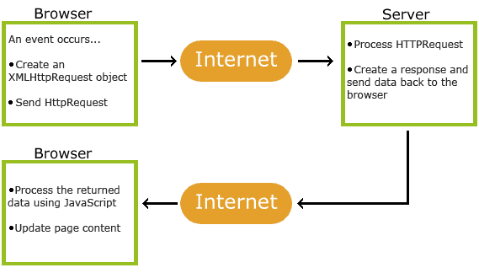
How AJAX Works

Slide 4
XMLHttpReqest Object
The XMLHttpRequest object is used to exchange data with a server behind the scenes. This means that it is possible to update parts of a web page, without reloading the whole page.
Allow for asynchronous Gets+Post to the server.
Does not the show the use anything no status messages.
Variable x=new XMLHttpRequest();

Slide 5
Send a Request To a Server
Variable xmlhttp=new XMLHttpRequest();
xmlhttp.open("GET","ajax_info.txt",true); xmlhttp.send();
Method | Description
open(method,url,async) | Specifies the type of request, the URL, and if the request should be handled asynchronously or not. method: the type of request: GET or POST url: the location of the file on the server async: true (asynchronous) or false (synchronous)
send(string) | Sends the request off to the server. string: Only used for POST requests

Slide 6
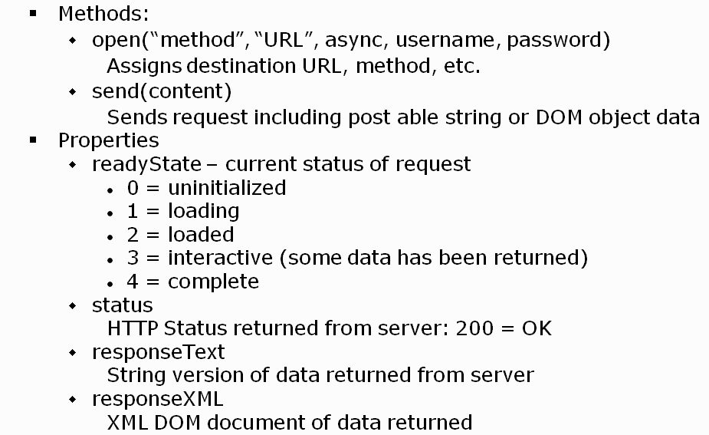
XMLHttpReqest Object

Slide 7
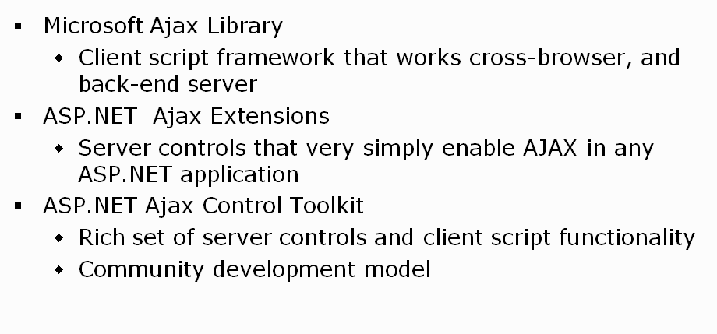
Asp. Net Ajax Components

Slide 8
Ajax Extensions
Asp.net is providing set of controls called Ajax extensions controls towards Ajax implementation at server side.
ScriptManager
UpdatePanel
UpdateProgress
Timer
ScriptManagerProxy

Slide 9
Script Manager Properties
<asp: ScriptManager ID="ScriptManger1" runat="Server" EnablePartialRendering="True"/>

Slide 10
Script manager
The ScriptManager makes sure that the required ASP.NET AJAX files are included and that AJAX support is added
ScriptManager control manages client script for AJAX enabled ASP.NET pages.
ScriptManger:
Download JavaScript files to client.
Enable partial-page rendering using Asp. Net Ajax extensions.
Provide access to Web Services via client-side proxies.
Manages callback timeouts ,providing error handling options and many more.
ScriptManager included on every page where you wish to use AJAX functionality.
Each page supports only one ScriptManager

Slide 11
Update panel
UpdatePanel allows to Partial-Page rendering.
It will AJAX'ify controls contained within it.
Update Panel Come with two child tags.
ContentTemplate:It holds the content of the panel, it can be either literal text or webcontrol.
Trigger Tag: Allows to define certain triggers which will update Updatepanel content
A Page can allow more than one Update Panel.

Slide 12
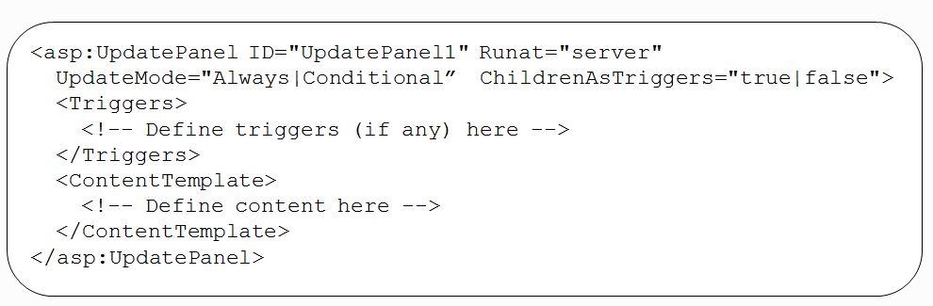
Update panel(Contd…)

Slide 13
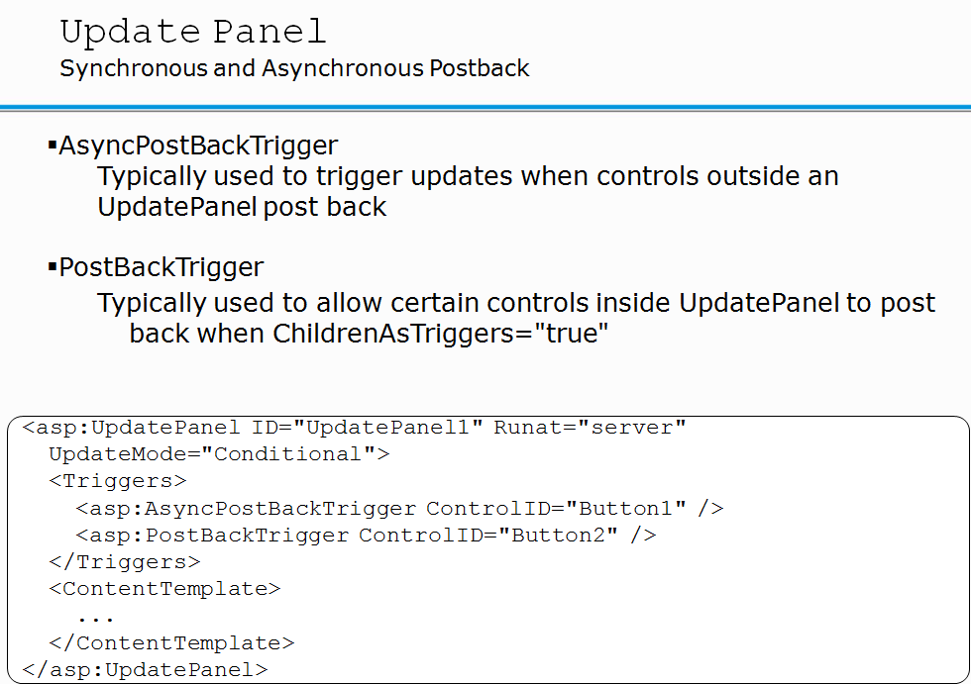

Slide 14
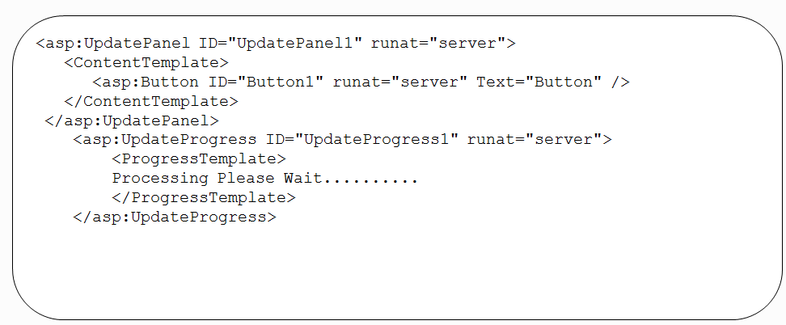
Update progress
User to show some progress state of partial-page updates.
it will display text or image when task is taking place on server.

Slide 15
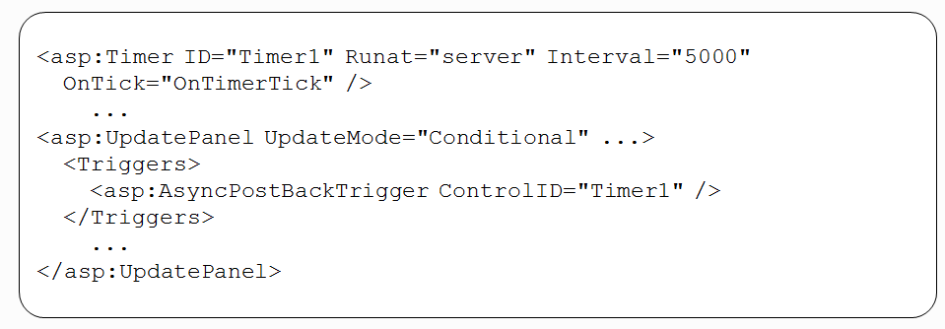
Timer control
User to Perform periodic postback.
User to perform partial-page updates with the help of UpdatedPanel

